Slide 1

From Manual to Automation: An Introduction to Coding for QA Testers
MI
Marjorie Ivy

Slide 2

About Me
Software Engineer @ Jonesboro Cycle & ATV
Software QA/QE for 15 Years
Handled various projects in different domains
Experience in both Web Application, API, and Mobile Application Testing
A current grad student taking Masters in Computer Science, at Georgia Institute of Technology, Fall 2024
LinkedIn: Marjorie Ivy | LinkedIn
Medium Articles: Medium
Github:

Slide 3
Introduction
This topic is designed for Quality Assurance testers who are eager to transition from manual testing to automation testing. We will explore the essential concepts and tools that will empower you to enhance the efficiency and effectiveness of your testing process. By the end of this topic, you will have a strong foundation in automation testing and be ready to embark on your automation journey!

Slide 4
Audience Background
Familiarity with Manual Testing Concepts
Familiarity with QA concepts
Basic or no knowledge of programming or coding concepts

Slide 5
Agenda
Addressing Automation Concerns
Why Automation is essential?
Writing your first script
Handling Test Data and Test Frameworks
Continuous Integration and Continuous Testing
Q&A
Introduction to Coding
Selecting the right tools/Setting up Environment

Slide 6
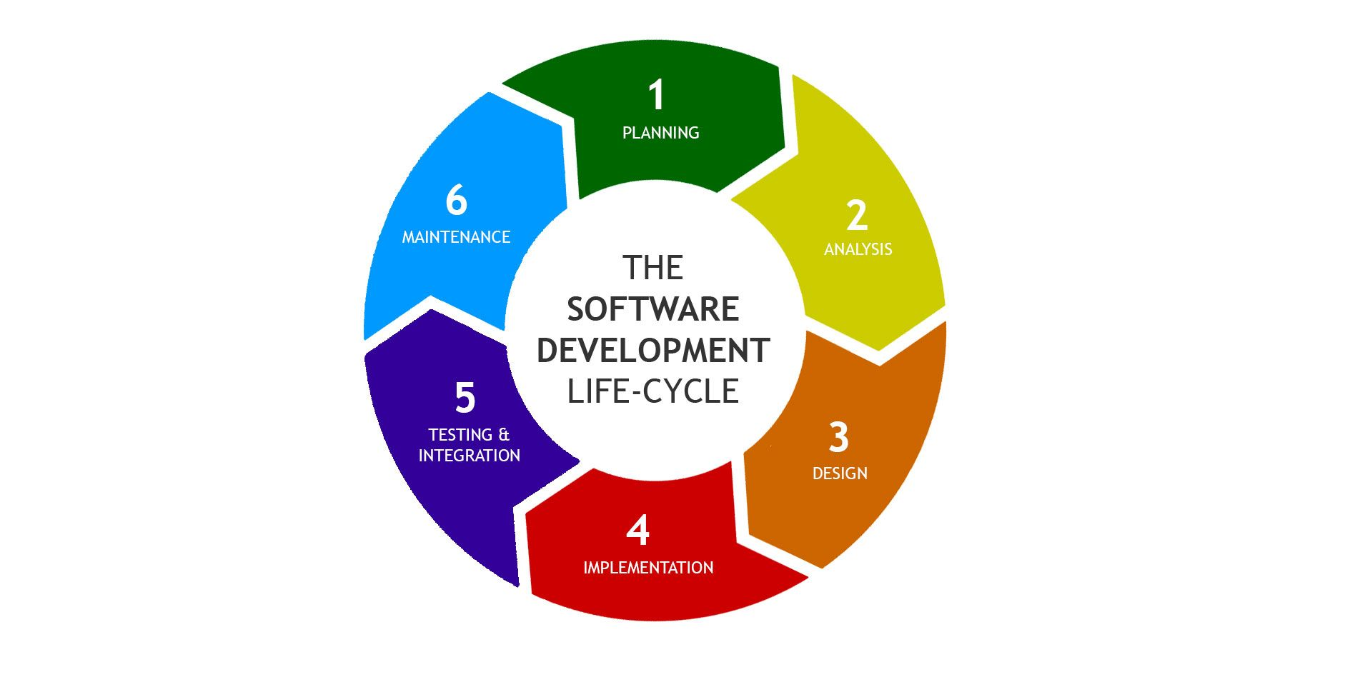
What is QA?
The Core of Quality Assurance
QA, or Quality Assurance, plays a pivotal role in ensuring that products meet the highest standards.
Conducting various testing types: functional, non-functional and regression.
QA involves comprehensive testing to validate functionality, performance and security.
It’s not just finding bugs; it’s about preventing them in the first place.

Slide 7
What is QA?
Understanding the role of QA
Collaborating with development teams to set quality standards.
Conducting various testing types: functional, non-functional and regression.
QA involves comprehensive testing to validate functionality, performance and security.
Notes:
Reference: Securing Software Quality (shmerling.net)

Slide 8
What is QA?
Challenges in Manual Testing
The Human Element
Limited Test Coverage
Scalability Issues
Resource Intensity

Slide 9
Addressing Automation Concerns
Concern | Solution
Lack of Automation Skills | Training programs, workshops, and online resources can help bridge this gap.
Resistance to Change | Open communication about the benefits of automation, addressing concerns, and demonstrating how automation complements manual testing rather than replacing it can help overcome resistance.
Limited Budget | Prioritize automation efforts based on critical test scenarios, explore open-source tools, and leverage free training resources.
Measuring Automation ROI | Define clear metrics for success, such as reduced testing time, increased test coverage, and fewer post-release defects.

Slide 10
Why Automation is Essential?
The Benefits
When To Consider Automation?
Accelerated Testing Cycles
Improved Test Accuracy and Consistency
Enhanced Test Coverage
Resource Optimization
Repetitive Test Scenarios
Large and Complex Applications
Frequent Code Changes
Performance and Load Testing
Notes:
Explain each of the benefits

Slide 11
Introduction To Coding
How Coding Fits into the Testing Process
The Role of Coding in QA
Writing Test Scripts
Integrating Coding with Test Cases
Enhancing Test Coverage
Notes:
Section1 : How Coding Fits into the Testing Process
Slide: The Role of Coding in QA*
Coding skills empower QA professionals to automate repetitive tasks and execute complex test scenarios.
We'll explore how coding enhances the efficiency and effectiveness of the testing process.
Slide: Writing Test Scripts*
Test scripts, written in code, enable automation of test cases.
We'll discuss how these scripts validate the functionality of software applications.
Slide: Integrating Coding with Test Cases*
Coding seamlessly integrates with the creation and execution of test cases.
Automation ensures faster, more reliable testing cycles.
Slide: Enhancing Test Coverage*
Coding allows for the creation of a comprehensive suite of test cases.
Automation extends the breadth and depth of test coverage.

Slide 12
Introduction To Coding
Basics of Coding
Python – as our language
Variables, Data Types, and Operators
Control Flow Structures
Classes and Objects
Functions and Modularization
Libraries

Slide 13
Introduction to Coding
Python
Python – high level, interpreted programming language, known for its readability and versatility.
It is widely used for machine learning, artificial intelligence, automation and web development.
It uses whitespace indention (unlike all other languages, they emphasize on the usage of ‘;’). Format is uncluttered, and often uses English keywords. Also, it doesn’t use curly brackets to delimit blocks. Semicolons are used after statements.
Python places importance on Code Readability and Simplicity.
Python (programming language) - Wikipedia
Notes:
Python (programming language) - Wikipedia

Slide 14
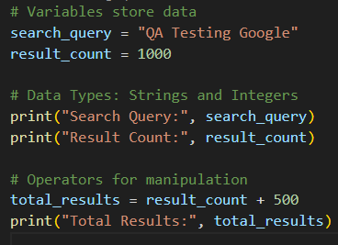
Introduction to Coding
Variables, Data Types and Operators
Variables: containers that store information.
Data Types: defines the kind of data a variable can hold, such as numbers, text, or true/false(boolean).
Operators: these are symbols or keywords that perform operations on variables and values.
Arithmetic Operators: Addition (+), Subtraction (-), Multiplication (*), Division (/).
Comparison Operators: Equal to (==), Not equal to (!=), Greater than (>), Less than (<).
Logical Operators: and, or, not
Notes:
Slide: Variables, Data Types, and Operators*
Understanding variables and data types forms the basis of coding.
Operators allow us to manipulate and process data efficiently.

Slide 15
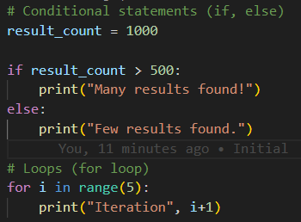
Introduction to Coding
Control Flow Structures
If statement: make decisions based on conditions
Else clause: an alternative path when the initial condition is not met.
Else if: check multiple conditions
Loops – For Loop: repeats a block of code
Notes:
Slide: Control Flow Structures*
Conditional statements (if, else) and loops control the flow of a program.
Mastery of control flow structures is key to creating logical and effective code.

Slide 16
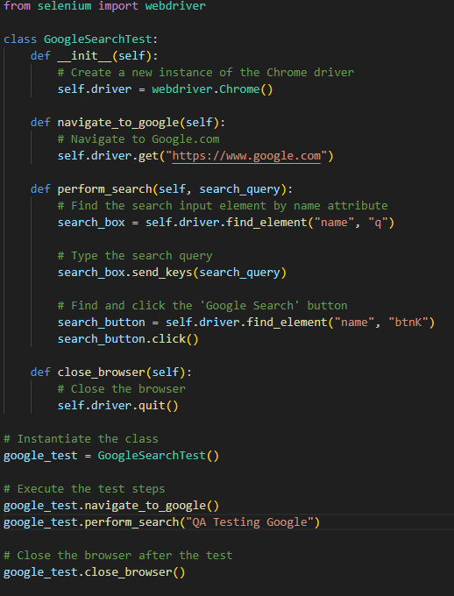
Introduction to Coding
Classes and Objects
Class: predefined set of rules or instructions for creating a specific type of test scenario or test case.
Objects: specific
Methods: series of steps to navigate through a test, then verify the result.
Attributes: input data, expected outcomes, or specific conditions.
Notes:
Change the screenshot here to show which is class/objects
Class (GoogleSearchTest):
The class GoogleSearchTest is a blueprint that defines a set of instructions for testing Google search functionality.
Attributes (self.driver):
self.driver is an attribute of the class. It represents an instance of the Selenium WebDriver (webdriver.Chrome()), allowing interaction with the web browser.
Methods (__init__, navigate_to_google, perform_search, close_browser):
__init__: This method is a constructor that initializes the class. It creates an instance of the Chrome driver (self.driver) when an object of the class is created.
navigate_to_google: This method navigates the browser to Google.com.
perform_search: This method performs a search on Google by locating the search input element, entering a search query, and clicking the 'Google Search' button.
close_browser: This method closes the browser, releasing resources.
Object (google_test):
google_test is an object instantiated from the GoogleSearchTest class. It represents a specific test scenario where a user navigates to Google,
performs a search, and closes the browser.
Putting It Together:
The class (GoogleSearchTest) provides a structure with methods and attributes for testing Google search functionality.
The object (google_test) is an instance of the class, representing a specific test case or scenario.
Methods of the class are applied to the object (google_test) to execute the steps of the test scenario.
In summary, this code demonstrates the concepts of class, attributes, methods, and objects in the context of testing Google search using Selenium.
The class defines the testing instructions, attributes represent elements to interact with, methods perform actions, and the object is an instance of a specific test scenario.

Slide 17
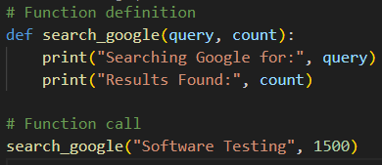
Introduction to Coding
Functions and Modularization
Functions: reusable block of code that performs a specific task.
Parameters and return values: parameters are inputs, and return values are outputs.
Modularization: practice of breaking down into smaller, independent modules or functions.
Benefits: Reusability, Readability and Maintenance.
Notes:
I think remove this? And instead, use google search and DOM as an example to transition to touger scripts

Slide 18
Introduction to Coding
Libraries
Selenium – test tool that is widely used for automation testing.
Handy tool – ready-to use commands that simplify tasks like opening a browser.
By
Find_element
Send_keys
click
A library is your go-to toolkit, offering ready-made solutions and saving you time in your manual testing work.
Do not reinvent the wheel! There are ready made solutions out there and you can re use these.
Notes:
Go back to this page later when creating a script.

Slide 19
Writing the first test script
QA Perspective
Test Cases – defines what needs to be tested
Test Scripts – this is written to automate the tests
Algorithms – can be used to enhance testing process and scenarios
A developer must rely on the requirements to code. A QA must rely on test cases to create our test scripts. Test cases are our Requirement ☺.

Slide 20
Writing the first test script
Python:
Pip install selenium
Download chrome driver: https://sites.google.com/chromium.org/driver/downloads
https://googlechromelabs.github.io/chrome-for-testing/#stable then copy it to the folder.
Install:
Pip install pytest-html
Run python –m pytest --html=report.html
Javascript:
Npm init –y
Npm install selenium-webdriver chromedriver
Npm install mochawesome
Change script to mocha test/*js –reporter mochawesome
When executing, use npm test
Pip install pytest-html-reporter

Slide 21
Writing the first test script
Manual Test Case
Test Objective: Verify the checkboxes on the website https://the-internet.herokuapp.com/checkboxes can be toggled successfully.
Preconditions:
Ensure you have a compatible web browser

Slide 22
Writing the first test script
Test Steps | Expected
Verify Page elements | Confirm that the page contains two checkboxes.
Toggle Checkbox 1 If Checkbox 1 is not already selected: Click on Checkbox 1. Verify that Checkbox 1 is now selected. | Checkbox 1 should be checked.
Toggle Checkbox 2 If Checkbox 2 is already selected: Click on Checkbox 2. Verify that Checkbox 2 is now deselected. | Checkbox 2 should be unchecked after Step 5
Close the browser | It closes the browser.

Slide 23
Handling Test Data and Test Frameworks
Manual Test Case
Login as Invalid User:
Go to https://the-internet.herokuapp.com/login
Enter invaliduser as username
Enter invalidpassword as password
Click Login
Verify the error message is displayed
Login as Valid User:
Go to https://the-internet.herokuapp.com/login
Enter as username
Enter as password
Click Login
Verify the success message is displayed
Click Logout

Slide 24
Handling Test Data and Test Frameworks
Manual Test Case
Test Objective: Verify that the login page on the website https://the-internet.herokuapp.com/checkboxes functions correctly for valid and invalid login scenarios.
Preconditions:
Ensure you have a compatible web browser

Slide 25
Writing the first test script
Valid Login
Test Steps | Expected
Verify Page Elements | Confirm that the login page contains username and password input fields, as well as a login button.
Perform Login For each set of test data from the "test_data.json" file. Enter the provided username and password into the respective input fields. Click the login button. | Verify that a success message is displayed.
Click Logout | Successfully logged out.
Close the browser | It closes the browser.

Slide 26
Writing the first test script
Invalid Login
Test Steps | Expected
Verify Page Elements | Confirm that the login page contains username and password input fields, as well as a login button.
Perform Login For each set of test data from the "test_data.json" file. Enter the provided username and password into the respective input fields. Click the login button. | Verify that an error message is displayed.
Clear input fields | All input fields are cleared out.
Close the browser | It closes the browser.

Slide 27
Handling Test Data and Test Frameworks
Unittest framework
Pytest framework
Both Pytest and Unittest are capable testing frameworks, and the choice between them often depends on personal preference, project requirements, and the testing ecosystem in use. Pytest is known for its simplicity, readability, and powerful features, while Unittest is part of the Python standard library, making it readily available without additional installations.
* Use JSON for configuration and pulling data when handling test data.

Slide 28
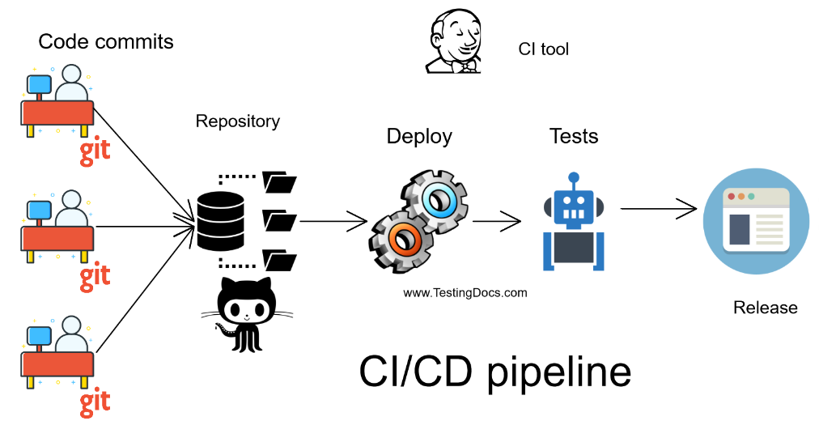
Introduction to CI/CT
Continuous Integration(CI)
Continuous Integration is a software development practice where changes made to the source code of an application are automatically integrated and tested frequently.
Components:
Automated Builds
Automated Testing
Version Control Integration
Continuous Feedback
Notes:
Continuous Integration Tools - TestingDocs.com

Slide 29
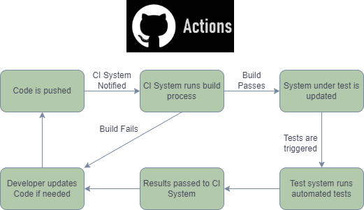
Introduction to CI/CT
Continuous Testing(CT)
Continuous Testing is an extension of CI that emphasizes the automated testing aspect throughout the entire software development lifecycle.
Components:
Automated Regression Testing
Parallel Test Execution
Performance Testing
Security Testing
Shift-Left Testing – early involvement of testing activities in the dev process.
Notes:
Continuous Integration Tools - TestingDocs.com
Instead of ci/ct maybe use git commands?

Slide 30
Selecting the Right Tools
Overview of the tools
Selenium
It is a robust testing framework for automating web browsers
It supports multiple programming languages(Python, Java, C#, Javascript) and facilitates cross-browser testing.
Mocha + Chai
Mocha, is a testing framework, that provides a structured environment for test creation and execution.
Chai is an assertion library that pairs seamlessly with testing frameworks like Mocha.
Appium
It is an open-source tool for automating mobile applications.
It allows for testing on both android and iOS platforms using a single codebase.

Slide 31
Selecting the Right Tools
Pros and Cons of the tools
Selenium
Pros: Excels in web automation
Cons: Not tailored for mobile apps.
Mocha + Chai
Mocha, is a testing framework, that provides a structured environment for test creation and execution.
Chai is an assertion library that pairs seamlessly with testing frameworks like Mocha.
Appium
It is an open-source tool for automating mobile applications.
It allows for testing on both android and iOS platforms using a single codebase.

Slide 32
Selecting the Right Tools
Other Testing Tools
Data Pipelines Testing
Great Expectations
Apache Kafka Streams TestUtils
Dbt(data build tool)
Apache beam test pipeline
Airflow Testing
Presto Test Framework
API
Postman
Insomnia
REST Assured
Karate DSL
Jest
SoapUI
API Contracts
Pact
Spring Cloud Contract
Consumer-Driven Contracts with Pact or Karate
Citrus
Hoverfly
Notes:
Testing data pipelines involves ensuring the correctness and reliability of data processing, transformation, and movement within your system. Here are some tools commonly used for testing data pipelines:
1. **Great Expectations:**
- **Description:** Great Expectations is an open-source Python library designed for data validation, documentation, and testing. It allows you to set expectations about your data, create tests, and verify the integrity of your data pipelines.
- **Key Features:**
- Declarative data validation.
- Extensive support for different data sources.
- Integration with popular data science and processing frameworks.
2. **Apache Kafka Streams TestUtils:**
- **Description:** If your data pipeline involves Apache Kafka for real-time data streaming, Kafka Streams provides testing utilities (TestInputTopic, TestOutputTopic) for writing unit tests for Kafka Streams applications.
- **Key Features:**
- Integration with Kafka for testing stream processing.
- Allows you to produce input and consume output for testing stream processing logic.
3. **dbt (data build tool):**
- **Description:** dbt is a command-line tool that enables data analysts and engineers to transform data in their warehouse more effectively. While not a testing tool in the traditional sense, it supports the concept of "tests" for asserting expectations about the data.
- **Key Features:**
- SQL-based transformations.
- Supports the definition of tests on transformed data.
4. **Apache Beam Test Pipeline:**
- **Description:** Apache Beam is a unified stream and batch processing model, and it provides a Test Pipeline library for testing Apache Beam pipelines. It allows you to write tests for your data processing logic using a test harness.
- **Key Features:**
- Testing both batch and stream processing pipelines.
- Verifying the correctness of your data transformations.
5. **Airflow Testing:**
- **Description:** Apache Airflow is a platform for orchestrating complex data workflows. While not a specific testing tool, it provides features for testing DAGs (Directed Acyclic Graphs), allowing you to simulate and test your data workflows.
- **Key Features:**
- Testing the workflow logic and task dependencies.
- Integration with different data processing systems.
6. **Presto Test Framework:**
- **Description:** Presto is a distributed SQL query engine, and its test framework enables you to test SQL queries and analyze query results for data processing accuracy.
- **Key Features:**
- SQL-based testing for distributed data processing.
- Supports running tests against Presto clusters.
Remember that the choice of tools depends on your specific use case, technology stack, and the nature of your data pipelines. Depending on your needs, you might use a combination of these tools to cover different aspects of testing within your data pipeline.
Certainly! Here are some pros and cons for the mentioned tools commonly used in testing data pipelines:
### 1. **Great Expectations:**
**Pros:**
- **Declarative Testing:** Allows you to express expectations about the data in a declarative way.
- **Data Profiling:** Provides features for data profiling, documentation, and exploration.
- **Extensible:** Supports various data backends and can be integrated with popular data science frameworks.
**Cons:**
- **Learning Curve:** It might have a learning curve for users not familiar with the declarative style of testing.
- **Python-Centric:** Primarily designed for Python users, which may not be suitable for environments using other languages.
### 2. **Apache Kafka Streams TestUtils:**
**Pros:**
- **Integration with Kafka:** Directly integrates with Apache Kafka for testing stream processing.
- **Convenient API:** Provides a convenient API for producing input and consuming output during testing.
**Cons:**
- **Specific to Kafka Streams:** Limited to testing Kafka Streams applications and might not be suitable for non-Kafka environments.
- **Java-Centric:** Primarily designed for Java users, which may not align with other language preferences.
### 3. **dbt (data build tool):**
**Pros:**
- **SQL-Based:** Allows analysts and engineers to express transformations using SQL.
- **Data Testing:** Supports data testing through the definition of tests on the transformed data.
- **Documentation Generation:** Automatically generates documentation for your data transformations.
**Cons:**
- **SQL Only:** Limited to SQL-based transformations, which might not cover all aspects of data processing.
- **Requires Warehouse:** Requires a data warehouse (e.g., BigQuery, Snowflake) for execution.
### 4. **Apache Beam Test Pipeline:**
**Pros:**
- **Unified Processing Model:** Supports both batch and stream processing in a unified model.
- **Test Harness:** Provides a test harness for writing unit tests for Apache Beam pipelines.
**Cons:**
- **Java-Centric:** Primarily designed for Java users, which may not align with other language preferences.
- **Learning Curve:** Might have a learning curve for users new to Apache Beam.
### 5. **Airflow Testing:**
**Pros:**
- **Workflow Orchestration:** Allows for testing the orchestration logic of your workflows.
- **DAG Testing:** Provides features for testing Directed Acyclic Graphs (DAGs).
**Cons:**
- **Complexity:** Apache Airflow might be overkill for simple data pipeline testing scenarios.
- **Learning Curve:** Learning curve associated with setting up and configuring Airflow.
### 6. **Presto Test Framework:**
**Pros:**
- **Distributed SQL:** Enables testing SQL queries in a distributed environment.
- **Integration with Presto:** Directly integrates with Presto for testing.
**Cons:**
- **Presto Dependency:** Tied to environments using Presto as a query engine.
- **SQL Only:** Focused on SQL-based testing, may not cover broader aspects of data pipeline testing.
Remember that the suitability of a tool depends on your specific use case, technology stack, and team expertise. Combining multiple tools might be necessary to cover different aspects of testing within your data pipeline.
Certainly! Here are some popular tools used for API testing, along with their respective pros and cons:
### 1. **Postman:**
**Pros:**
- **User-Friendly Interface:** Intuitive and user-friendly interface for creating and running API tests.
- **Rich Feature Set:** Offers features for testing, automation, and collaboration.
- **Environment Variables:** Allows the use of environment variables for flexibility in testing different environments.
**Cons:**
- **Learning Curve:** Advanced features may have a learning curve for beginners.
- **Dependency on GUI:** While it has a command-line interface, some features are more GUI-centric.
### 2. **Insomnia:**
**Pros:**
- **Simplified Interface:** Clean and straightforward interface for designing and executing API tests.
- **Workspaces:** Supports the organization of API requests into workspaces for better project management.
- **Environment Variables:** Allows the use of environment variables for dynamic testing.
**Cons:**
- **Smaller Ecosystem:** Smaller community compared to some other tools.
- **Feature Set:** Some advanced features found in other tools may be limited.
### 3. **REST Assured:**
**Pros:**
- **Java Integration:** Well-suited for Java-based projects, integrates seamlessly with Java testing frameworks.
- **Declarative Syntax:** Uses a declarative syntax for writing tests, making them more readable.
- **Extensible:** Can be extended for complex testing scenarios.
**Cons:**
- **Java-Centric:** Primarily designed for Java, may not be as suitable for non-Java projects.
- **Learning Curve:** May have a learning curve for users new to Java or API testing.
### 4. **Karate DSL:**
**Pros:**
- **BDD Syntax:** Utilizes a behavior-driven development (BDD) syntax for expressive tests.
- **Integrated Testing:** Combines API testing, performance testing, and UI automation.
- **Zero Setup:** Requires minimal setup and configuration.
**Cons:**
- **Limited Ecosystem:** Smaller community and ecosystem compared to more established tools.
- **Not as Feature-Rich:** Some advanced features found in other tools may be missing.
### 5. **Jest:**
**Pros:**
- **JavaScript/Node.js Integration:** Well-suited for JavaScript and Node.js projects.
- **Unit Testing:** Initially designed for unit testing but can be used for API testing with additional plugins.
- **Snapshot Testing:** Supports snapshot testing for responses.
**Cons:**
- **Unit Testing Focus:** While it can be used for API testing, it is primarily a unit testing framework.
- **Learning Curve:** May have a learning curve for users new to Jest.
### 6. **SoapUI:**
**Pros:**
- **SOAP and REST Support:** Supports both SOAP and REST APIs.
- **Rich Feature Set:** Comprehensive features for testing, mocking, and load testing.
- **Data-Driven Testing:** Allows for data-driven testing scenarios.
**Cons:**
- **Complexity:** Can be complex for simple API testing scenarios.
- **Resource Intensive:** May consume more resources compared to lighter tools.
Remember to choose a tool based on your specific project requirements, team expertise, and the nature of your API testing needs. It's also common to see a combination of tools used, depending on the context and goals of your testing efforts.
API contract testing frameworks are tools designed to verify that the interactions between different services or components in a system adhere to a specified contract. These contracts define the expected behavior of the APIs, including request and response formats, status codes, and other constraints. Here are some popular API contract testing frameworks:
1. **Pact:**
- **Description:** Pact is a contract testing tool that works by allowing different services to define their expectations (Pacts) and then verifying those expectations in a consumer-driven manner.
- **Pros:**
- Supports multiple programming languages.
- Lightweight and easy to set up.
- Integrates with various build and CI/CD tools.
- **Cons:**
- Learning curve for those new to contract testing concepts.
2. **Spring Cloud Contract:**
- **Description:** Spring Cloud Contract is a framework that supports contract testing in a Spring-based microservices architecture. It allows teams to define contracts using Groovy DSL or YAML.
- **Pros:**
- Integrates seamlessly with the Spring ecosystem.
- Supports contract testing for both HTTP and message-based interactions.
- Can be used with various languages, not limited to Java.
- **Cons:**
- May be more suited for Java/Spring projects.
3. **Consumer-Driven Contracts (CDC) with tools like Karate or Pact:**
- **Description:** Consumer-Driven Contracts is a testing approach where consumers of an API specify their expectations, and these expectations are used to verify the provider's compliance.
- **Pros:**
- Encourages collaboration between API providers and consumers.
- Clear and expressive DSL for defining contracts.
- **Cons:**
- Requires collaboration between teams, which might be a challenge in certain scenarios.
4. **Citrus Framework:**
- **Description:** Citrus is a versatile framework for integration and end-to-end testing. It supports contract testing through the definition of message templates and validation scripts.
- **Pros:**
- Supports multiple transport protocols and message formats.
- Extensive documentation and community support.
- Can be used for broader integration testing scenarios.
- **Cons:**
- May be overkill for simple contract testing needs.
5. **Hoverfly:**
- **Description:** Hoverfly is a lightweight, open-source API simulation tool that supports contract testing. It allows you to capture real HTTP traffic and create simulations for testing purposes.
- **Pros:**
- Easy to set up and use.
- Can be used for virtualization and contract testing.
- **Cons:**
- Might not be as feature-rich as dedicated contract testing frameworks.
Remember that the choice of a contract testing framework depends on your project's requirements, the technology stack in use, and the preferences of your development and testing teams. Each framework has its strengths, and the most suitable one for your project will depend on your specific context.

Slide 33

Title Goes Here

